Slide 1
Rich Gutter
template

Slide 2
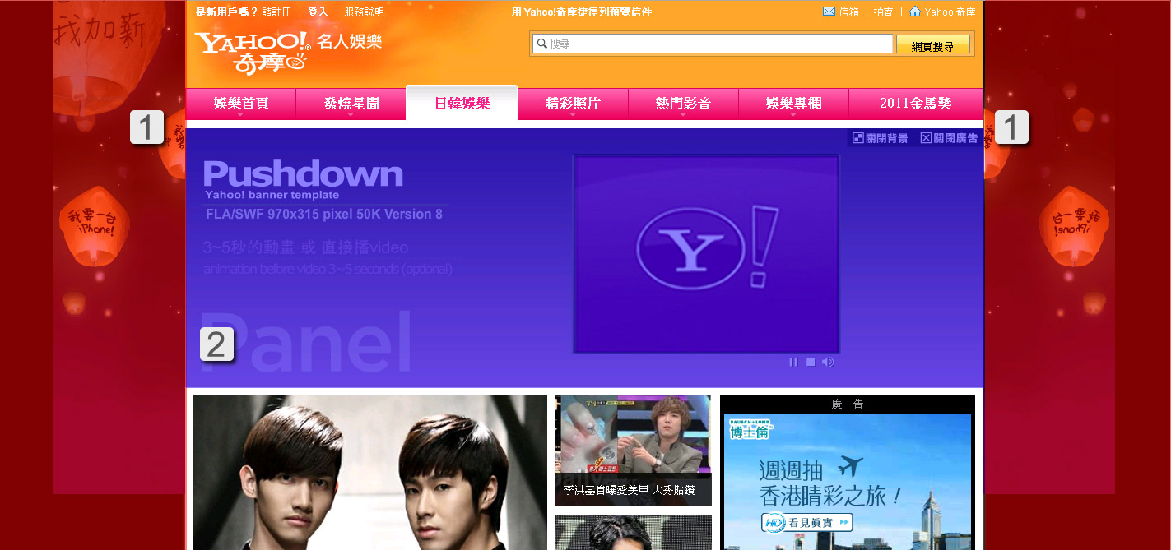
Rich Gutter │presentation
Advertising composition :
1. Both sides of the flash background and background 2. 970 Pushdown
Cognitive issues before production :
‧Rich Gutter needs working with Pushdown, not exist independently.
‧ Rich Gutter both sides of the flash size is 160x600.

Slide 3
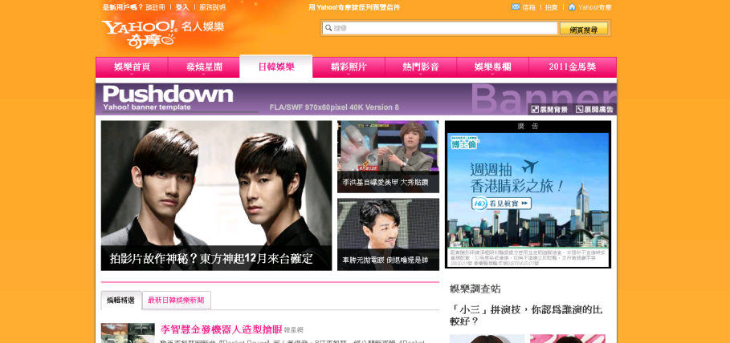
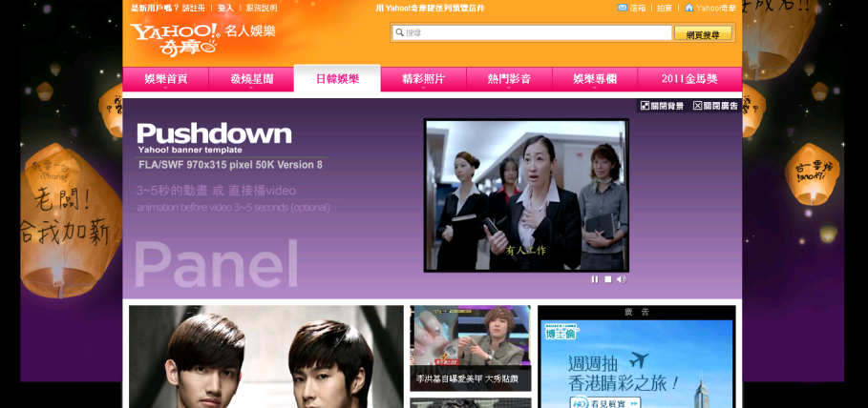
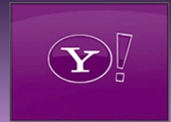
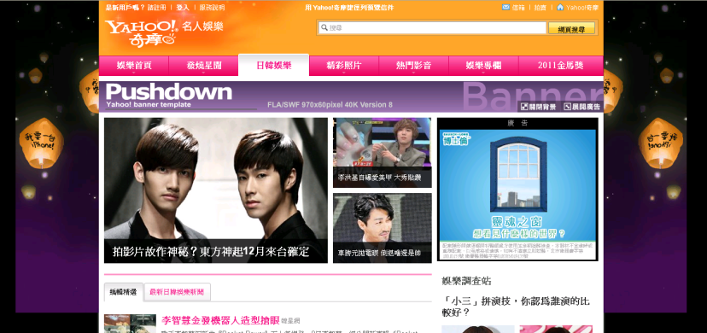
Rich Gutter │presentation
Interpretation : Into the page , background turned on by default status .
To enter the page, the background base maps turned on by default.
Clicking to close .
Clicking background once again started .
This close button and close bachground button should remain on the upper right corner at all time. The color and font style can be modified where the font size should remain the same 。

Slide 4
Rich Gutter │presentation
The background / background color can choose each or all with them .
Both sides of the background ：size :160x 600 (px) .
Located on both sides of the top of the page, the background will move with the scroll bar to scroll .
BG-color： May not be too shiny, not easy to read, do not use fluorescent colors 。

Slide 5


Rich Gutter │presentation
Interpretation :When the ad expands ,interpretation of the right and left sides animation / background at the same time , play 10 seconds of animation stationary
First Appearance
Both sides of the background flash interactive with Pushdown , after 10 seconds of synchronized , animation stop.
Need to click again the button of banner (970x90) ,it will re-interactive .
Laster Appearance
The banner (970x60)of Pushdown presents with both sides of the background static environment.
Press the banner (970x90) of Pushdown's "expand ad" button, on both sides of the background flash the basemap Skip animation sub-environment interaction 10 seconds again .

Slide 6

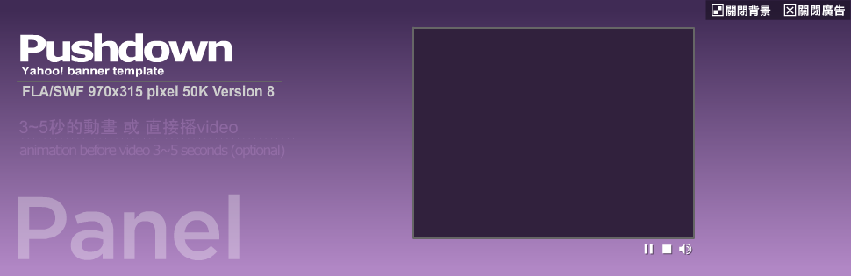
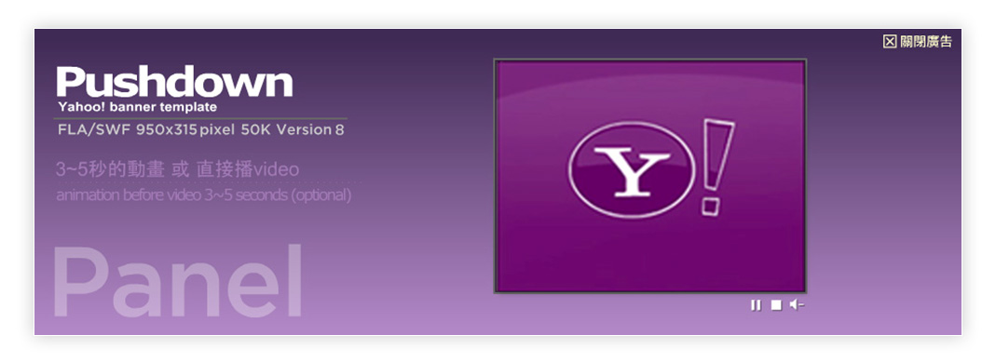
Rich Gutter- Pushdown│ad assembly
video version : The ad expands (970x315 pixels) automatically and video start playing with mute turn on. After the video finishes, the ad collapses to 970x90 pixels
Automatically expand to 30 seconds
After 30 seconds, automatically retracts Banner(970x90)
Non-video version : For expanded panel without Video, first appearance , the Max animation time is 10 Seconds.
Later appearance: The ad will only be expanded by user initiated. The Video would then be playing with audio.

Slide 7
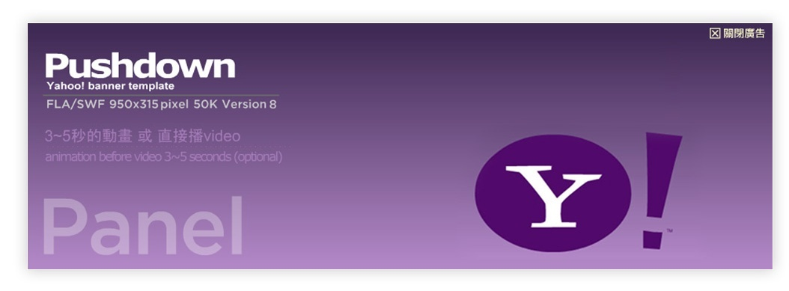
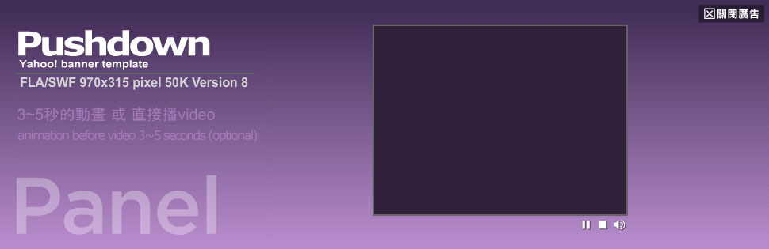
Rich Gutter- Pushdown│ad assembly
Non-video version : Only a simple Flash animation, Panel (970x315),
the animation max 10 seconds ,on loop.
Flash after max 10 seconds animation , still.
Video version : For expanded panel with video, Maximum flash animation is 10 seconds , no loop.
(animate before video play)
If the movie has already 30 seconds , it is recommended to omit the 3 to 5 seconds start animation , or video simultaneously.
Flash after max 10 seconds animation , still.

Slide 8
Rich Gutter- Pushdown│note
Banner (970x90)
button:
button (compulsory)
‧ Icon / font / size / font / position / color need to be consistent, not adjusted .
Production :
‧ To still stationary after 5 seconds animation, non-loop.
Backup image (970x90)
If browser can't play Flash, ad will present with backup image ; the backup image without "展開廣告" button.

Slide 9

Rich Gutter- Pushdown│ note
Panel (970x315)
Close bg / Open bg
Close ad
If the video ratio is 4:3,
Player area should also be 4:3
Same case for ratio 16:9
Video Control button
Button:
關閉廣告，關閉背景 / 展開背景 button :
‧ Please maintain a fixed position at the top right . Font / size do not change, but according to the design change color.
Video Control button :
‧ Button borders and backgrounds can be customized.
‧ Color variation is allowed on mouse rollover.
‧ Play / Stop / Pause / Sound: can be customized to different colors and sizes.

Slide 10
Rich Gutter- Pushdown│ note
Banner (970x90)
‧ To still stationary after 5 seconds animation, non-loop.
Backup image(970x90)
‧If browser can't play Flash, ad will present with backup image ; the backup image without "展開廣告" button.
Panel (970x315)
‧關閉廣告，關閉背景 / 展開背景 button, please maintain a fixed position at the top right . Do not change font size , but the font can be changed color.
‧non-video version , max 10 seconds animation , no loop .
‧video version， max 10 seconds animation , no loop . ； video max 30 seconds ( with initial animation)。
‧video control button Icon design unchanged , but you can change color or add background to decorate .

Slide 11

Rich Gutter │presentation
Masthead can’t have ：
1. LOGO 2. Any text or text in the image
MASTHEAD with the same height

Slide 12
Rich Gutter │presentation
Masthead can’t have ：
No SP message (not the price ,special offers, discounts information)
MASTHEAD with the same height

Slide 13
Rich Gutter │ Specification Summarize
Fla files
items | Dimension (Width x Height pixels) | File Formats | Max. KB
Panel | 970x315 (The panel can contain up to 3 buttons which is link to individual flash file with Max. size of 50K each.) | swf & fla | 50K
Banner | 970x90 | swf & fla | 40K
Backup Image | 970x90 | gif or jpg | 30K
Video files
items | Dimension (Width x Height pixels) | File Formats | Max. KB
video | 1.If the video ratio is 4:3, Player area should also be 4:3 Same case for ratio 16:9 2.Max. duration: 30 seconds 3.The video width should be wider than 320 pixels (for ratio 4:3) | MOV /AVI / wmv | 100MB

Slide 14
Rich Gutter │ Specification Summarize
items | Dimension (Width x Height pixels) | File Formats | Max. KB | version
BackSkin | 1290 x 600 | SWF / FLA | 100K | Flash Player 8 / AS2
Background material required to provide :
items | 內 容
Background color | RGB（ex #FFF8DC）
‧Rich Gutter musts play with Pushdown 。
‧ Material needed to audit by Yahoo! , prohibited SP activities exposed .
‧ Because of the need to audit, the set of syntax and production test page ,plase provide the material before 7 working days .

Slide 15
For further questions, please contact:
tw-adtech@yahoo-inc.com

